Slide 1
DIABETIC RETINOPATHY
SEVERITY CLASSIFICATION
USING VISION TRANSFORMER
ARJUN AJAYAKUMAR
ROLL NO:16

Slide 2
ABSTRACT
Diabetic Retinopathy is a serious eye disease that can cause blindness if not detected early.
Manual diagnosis is time-consuming and requires specialists.
This project develops an automated system to classify DR severity from retinal images.
Images are preprocessed and analyzed using a Vision Transformer model.
The system classifies the disease into five severity levels.
It provides fast, accurate results through a simple web interface.
The system supports early detection and improves screening efficiency.

Slide 3
Problem Identification
Increasing number of diabetic patients
Manual diagnosis is slow
Requires experienced ophthalmologists
Not suitable for large-scale screening
Limited medical experts in rural areas

Slide 4
Problem Statement
Diabetic Retinopathy is a major cause of vision loss
Manual diagnosis requires expert ophthalmologists
Process is time-consuming and subjective
Large-scale screening is difficult
Need for an automated, accurate, and efficient system

Slide 5
Proposed System
An automated system to detect Diabetic Retinopathy severity from retinal images.
Users upload retinal fundus images through a web interface.
Images are preprocessed to improve quality.
A Vision Transformer model analyzes the image.
The system predicts the DR severity level with confidence score.
Provides fast and accurate results for early diagnosis

Slide 6
Modules of Proposed System
Module 1: Image Upload
Allows users to upload retinal images.
Module 2: Image Preprocessing
Image resizing
Normalization
Contrast enhancement
Module 3: Model Prediction
Vision Transformer analyzes the image
Classifies DR severity level
Module 4: Result Display
Shows predicted class
Displays confidence score

Slide 7
Tools and Technologies
Programming Language
Python
JavaScript
Deep Learning Framework
PyTorch / TensorFlow
Image Processing
OpenCV
Pillow
Web Framework
Flask
Frontend
HTML
CSS
JavaScript
Development Tools
Google Colab
VS Code

Slide 8
Disease Classification
No DR
Mild
Moderate
Severe
Proliferative DR

Slide 9
Literature Review

Slide 10
TITLE & YEAR | AUTHOR & PUBLICATION | ALGORITHM USED | FEATURE EXTRACTED / METHODOLOGY | PERFORMANCE METRIC | RESULT / FINDINGS
A Deep Learning Based Model for Diabetic Retinopathy Grading (2025) | Samia Akhtar et al. | CNN (RSG-Net) | Histogram Equalization, Gaussian Blur, Data Augmentation (flip, rotate, zoom), CNN with Batch Normalization | Accuracy, Sensitivity, Specificity | Achieved 99.36% accuracy (4-class) and 99.37% accuracy (binary classification). Outperformed existing state-of-the-art methods.

Slide 11
TITLE & YEAR | AUTHOR & PUBLICATION | ALGORITHM USED | FEATURE EXTRACTED / METHODOLOGY | PERFORMANCE METRIC | RESULT / FINDINGS
Diabetic Retinopathy Detection Using Machine Learning (2025) | Reeta Shaktivel | CNN + ResNet50 + InceptionV3 | Feature extraction using pretrained models, fundus image classification | Accuracy, Sensitivity, Specificity, F1-score | Achieved 98.65% average accuracy, improved early-stage detection compared to traditional ML models.

Slide 12
TITLE & YEAR | AUTHOR & PUBLICATION | ALGORITHM USED | FEATURE EXTRACTED / METHODOLOGY | PERFORMANCE METRIC | RESULT / FINDINGS
Enhancing Diabetic Retinopathy Detection Through Federated CNN (2025) | Saad Alanazi et al. — Alexandria Engineering Journal | Federated CNN + VGG19 | SMOTE (class balancing), Wiener & Median filtering, VGG-based feature extraction | Detection Accuracy | Demonstrated scalable and privacy-preserving DR detection with improved multi-stage classification performance.

Slide 13
TITLE & YEAR | AUTHOR & PUBLICATION | ALGORITHM USED | FEATURE EXTRACTED / METHODOLOGY | PERFORMANCE METRIC | RESULT / FINDINGS
Deep Learning for Enhanced Prediction of Diabetic Retinopathy (2025) | Weijun Gong et al. — Frontiers in Medicine | Deep Neural Network (DNN) | Structured clinical data analysis, SHAP interpretability | Accuracy, F1-score, AUC | DNN achieved 0.778 accuracy and 0.833 AUC, outperforming logistic regression, SVM, random forest and other ML models.

Slide 14
TITLE & YEAR | AUTHOR & PUBLICATION | ALGORITHM USED | FEATURE EXTRACTED / METHODOLOGY | PERFORMANCE METRIC | RESULT / FINDINGS
Diabetic Retinopathy (DR): Mechanisms, Current Therapies, and Emerging Strategies (2025) | Hyewon Seo et al. — Cells (MDPI) | Deep Neural Network | Molecular mechanisms, Anti-VEGF therapy analysis, AI-based diagnosis discussion | Clinical outcome analysis | Identified limitations of current anti-VEGF therapies and highlighted need for AI-based early detection and advanced treatment strategies.

Slide 15
Comparison With Existing System
Feature | Existing System | Proposed System
Diagnosis Method | Manual examination | AI-based automated detection
Speed | Slow | Fast
Accuracy | Depends on expert | High accuracy using Vision Transformer
Screening | Limited | Suitable for large-scale screening
Accessibility | Requires hospital visit | Web-based system

Slide 16
DATA FLOW DIAGRAM

Slide 17
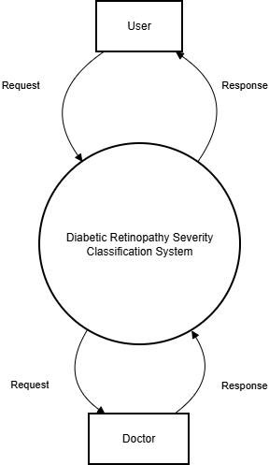
DFD Level 0

Slide 18
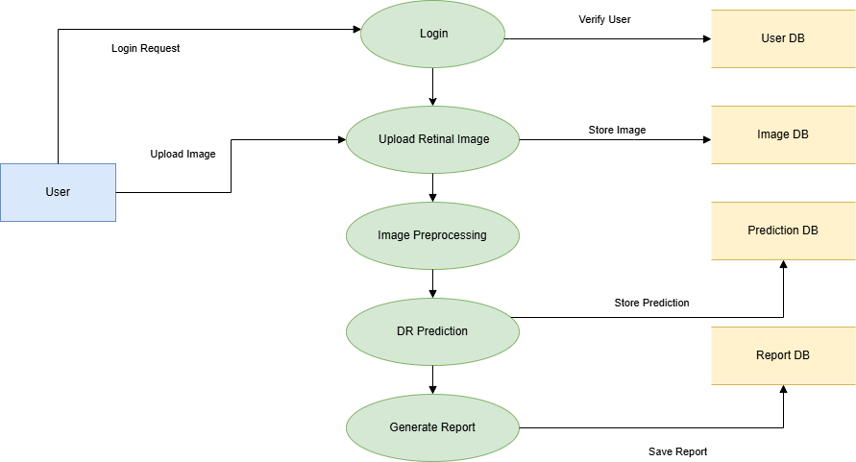
DFD Level 1

Slide 19
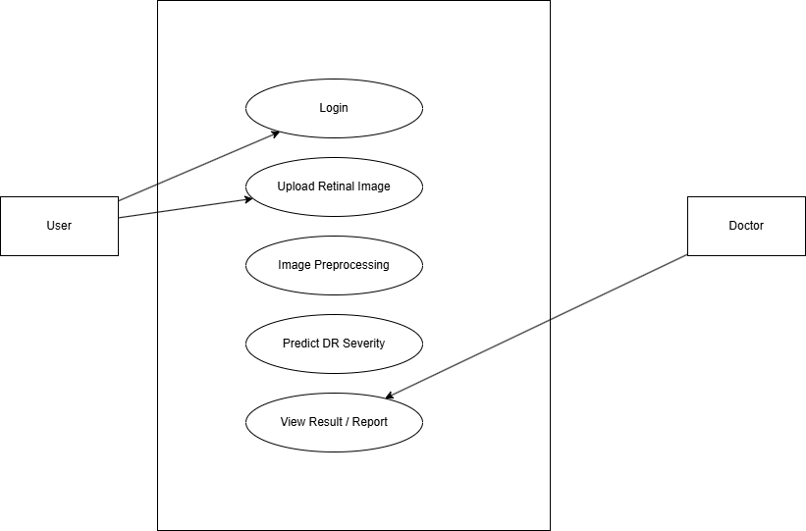
Usecase Diagram

Slide 20
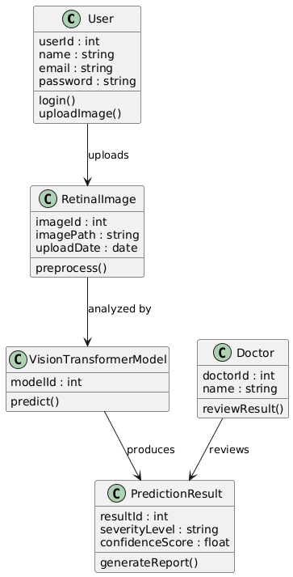
Class Diagram

Slide 21
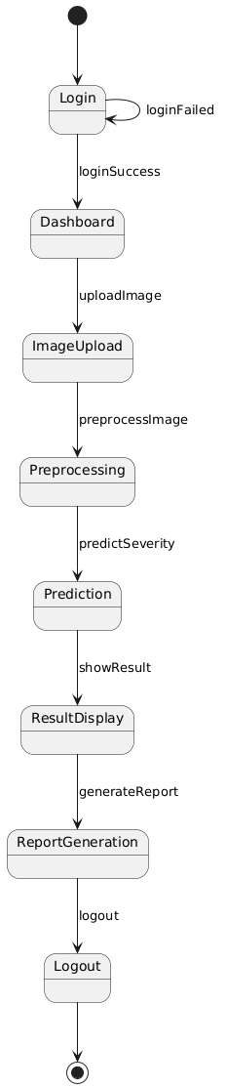
State Diagram

Slide 22
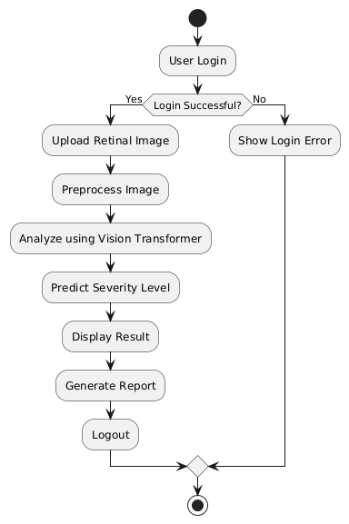
Activity Diagram

Slide 23
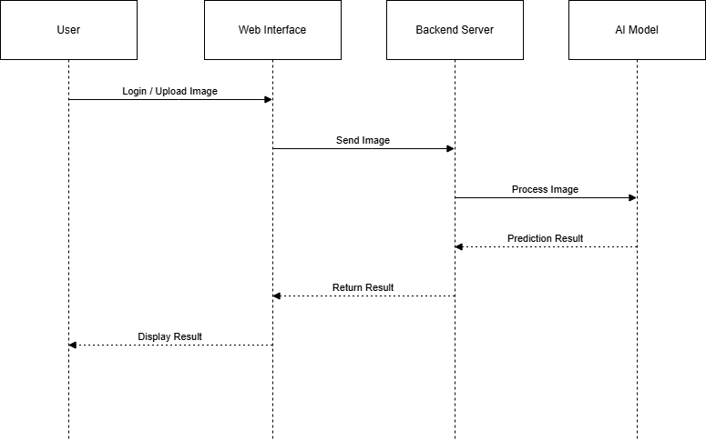
Sequence Diagram

Slide 24
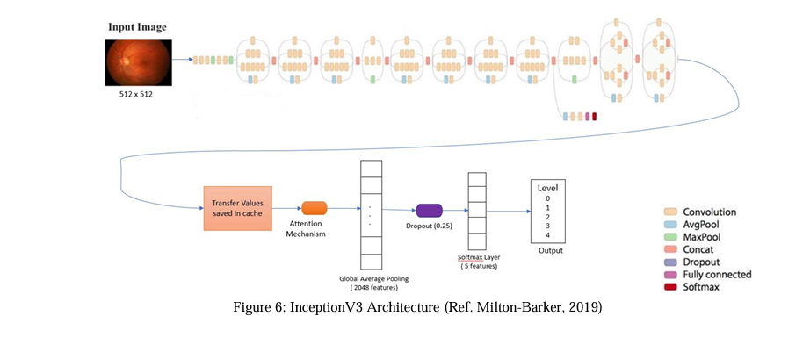
Architecture Diagram

Slide 25
Algorithm
User uploads retinal image.
Image is preprocessed.
Image is fed into Vision Transformer model.
Model extracts features
Model predicts severity class.
System displays result with confidence score.

Slide 26
Limitations
Model accuracy depends on dataset quality.
Requires high computational power.
Internet required for web system.
Model extracts features
May not replace expert ophthalmologists completely.
Incorrect image quality affects prediction.

Slide 27
Future Scope
Develop a mobile application for easy retinal image screening.
Implement real-time diabetic retinopathy detection for faster diagnosis.
Integration with IoT retinal cameras.
Extend the system to detect multiple eye diseases along with diabetic retinopathy.
Improve the system using larger retinal image datasets for better accuracy.
Develop a low-cost screening system for rural healthcare centers.

Slide 28
Project Link
Click below to open the project 👇
https://retinaaibyarj.streamlit.app

Slide 29
THANK YOU

